Slide 1
Event Queue
Hanoi, June 2017

Slide 2
Introduction
Event-driven framework
Multiple events may arrive at the same time
Event queue is needed

Slide 3
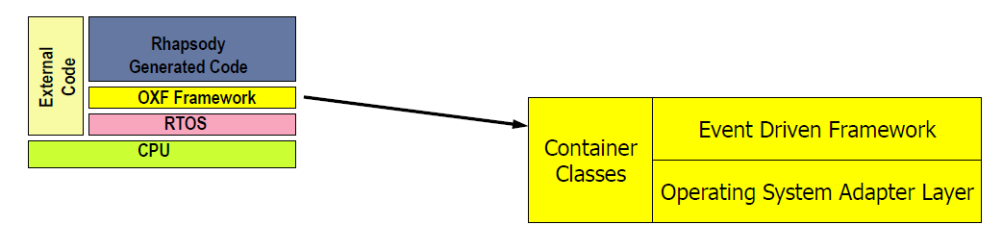
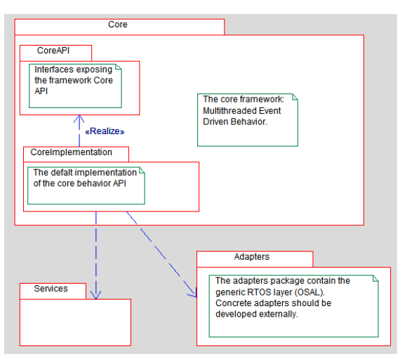
Event-driven framework in Rhapsody

Slide 4
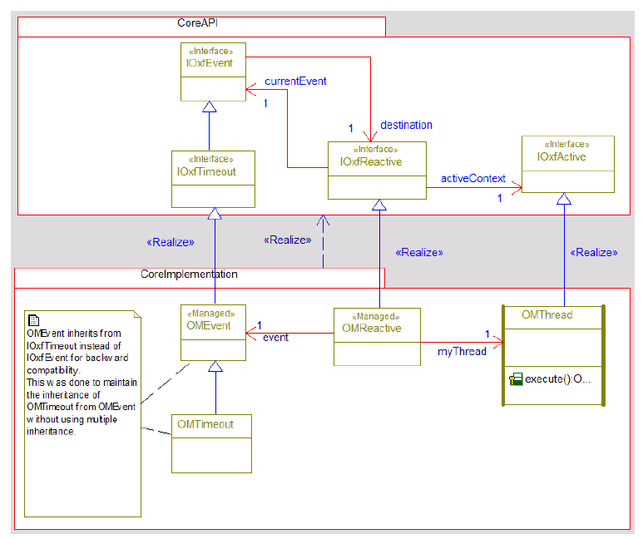
OXF

Slide 5
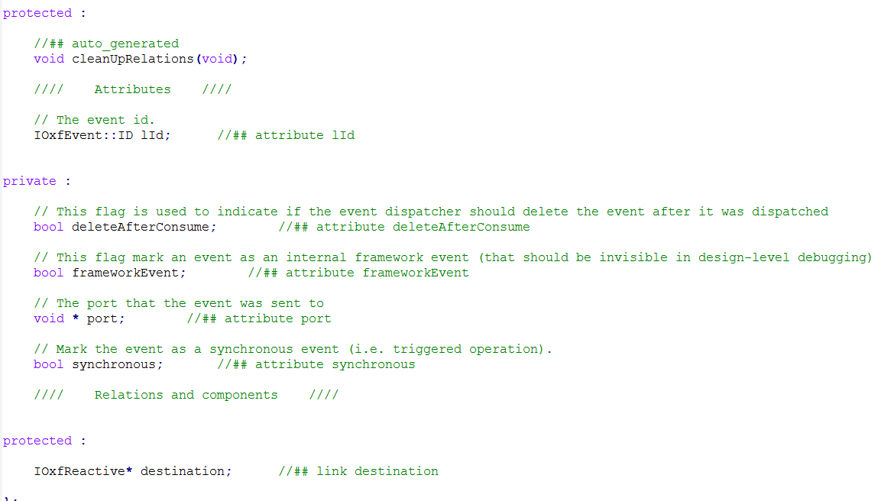
OMEvent

Slide 6
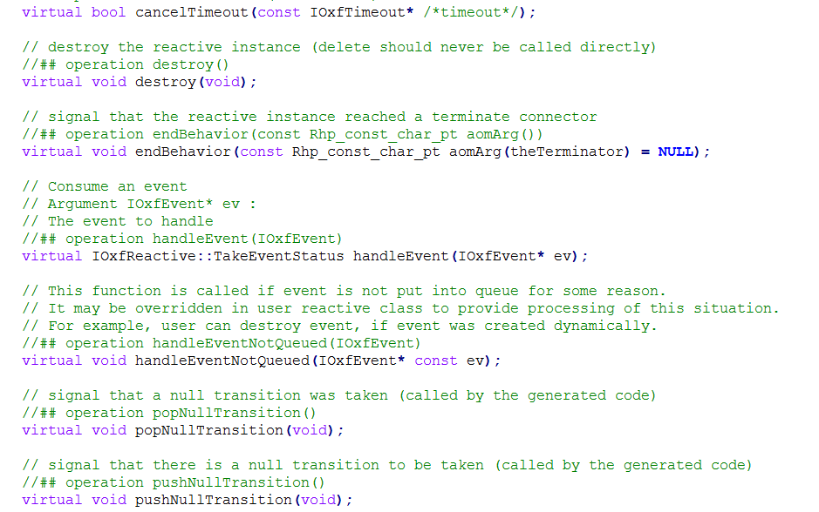
OMReactive

Slide 7
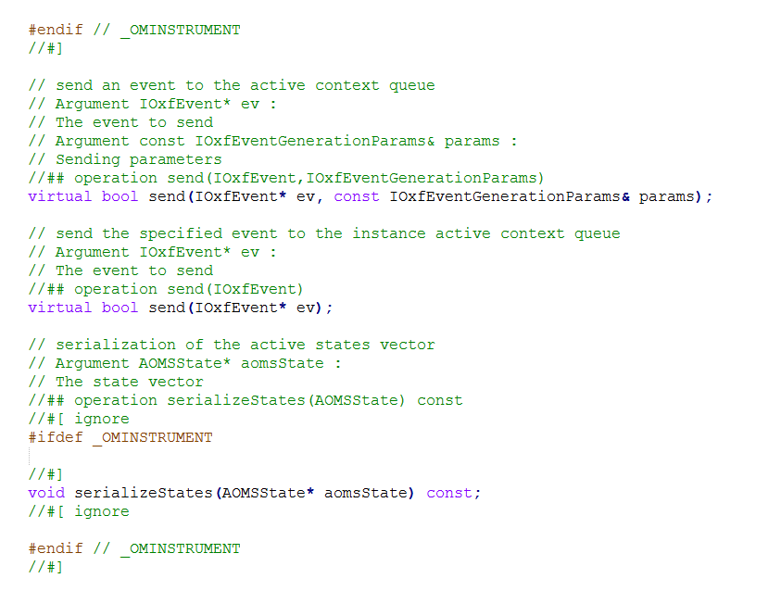
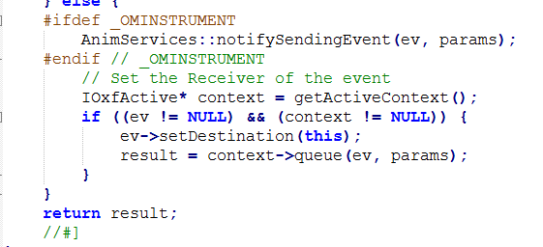
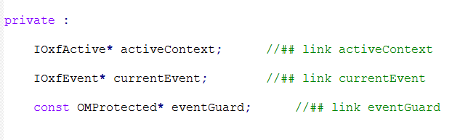
OMReactive (cont.)

Slide 8
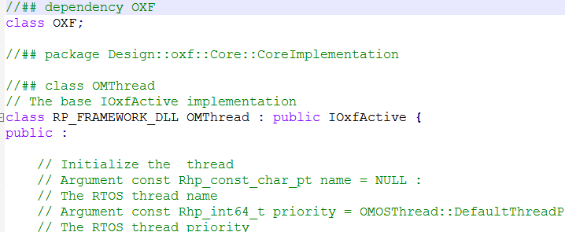
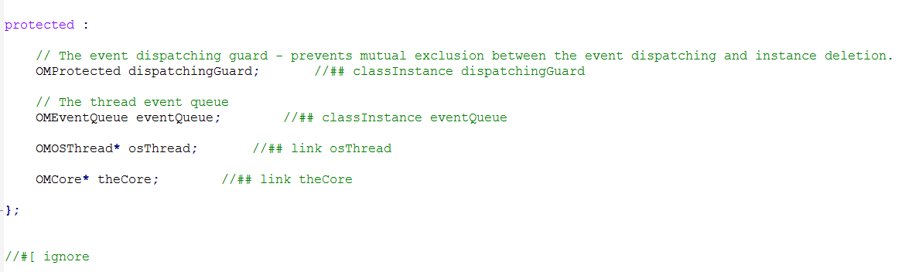
OMThread

Slide 9
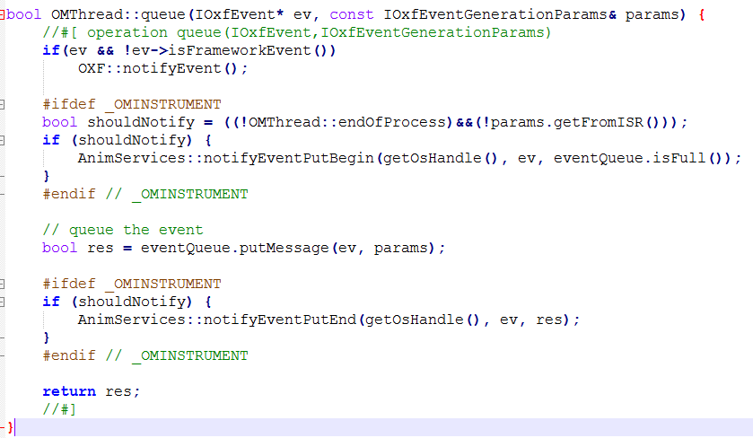
OMThread

Slide 10
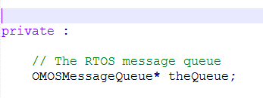
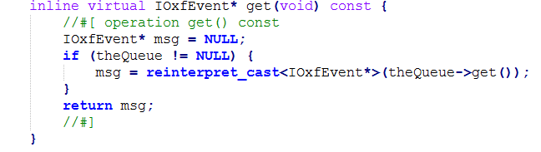
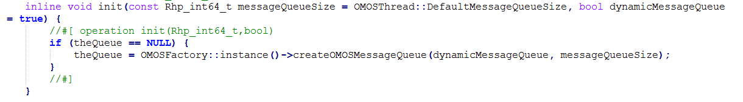
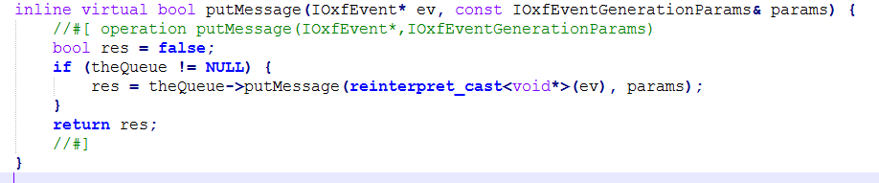
OMEventQueue

Slide 11
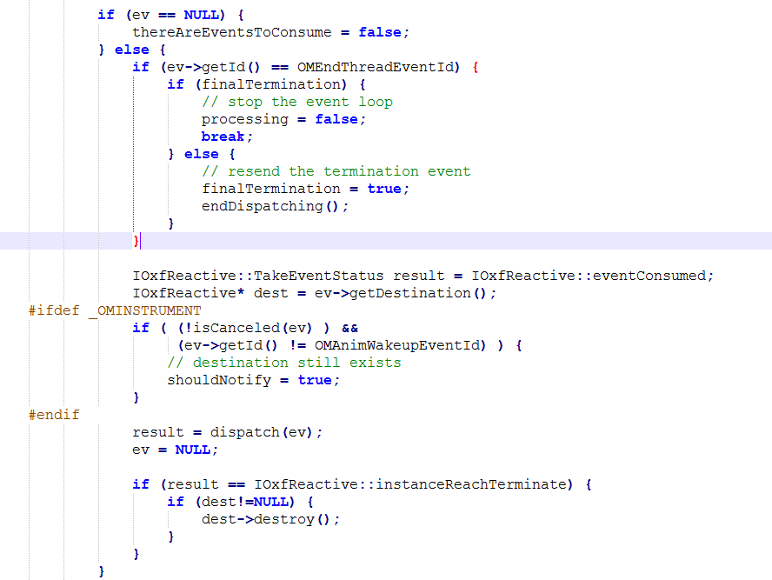
Execute

Slide 12
Current Application on our Model
Branch: EventQueueTest
Done:
Adding a separate Thread for EventQueue
Put event in Queue
Get event from Queue and Execute

Slide 13
Components
Each Component class inherit:
Defined by us:
IStateObserver
HMIComponentBase
By Rhapsody:
- OMReactive

Slide 14
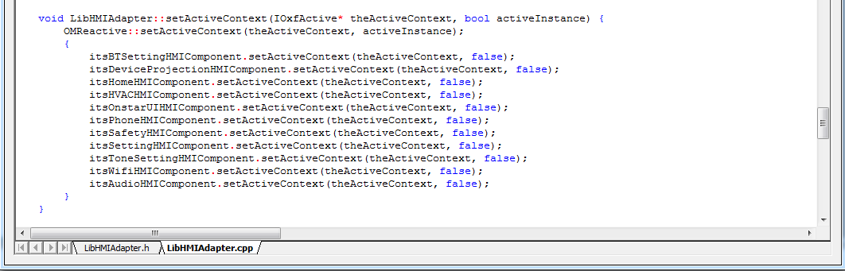
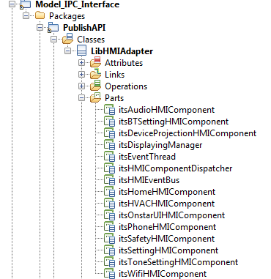
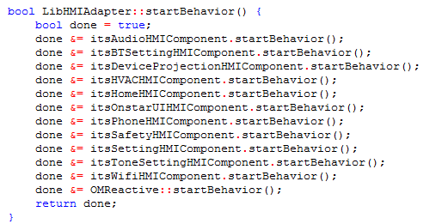
Auto generated code
???

Slide 15
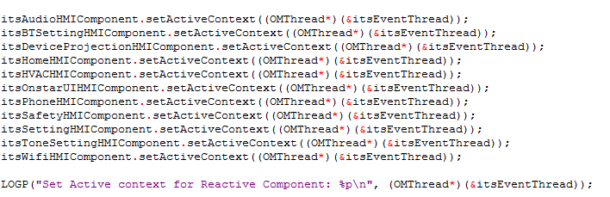
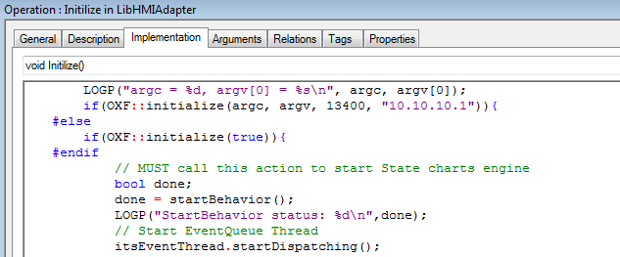
What are necessary for OMReactive
ActiveContext (OMThread):
OMReactive need to know where events are processed on => The active context (event dispatcher) of the reactive instance.
startBehavior()
- This method initializes the behavioral mechanism and takes the initial (default) transitions in the statechart before any events are processed. After this call is completed, the statechart is set to the initial configuration.

Slide 16
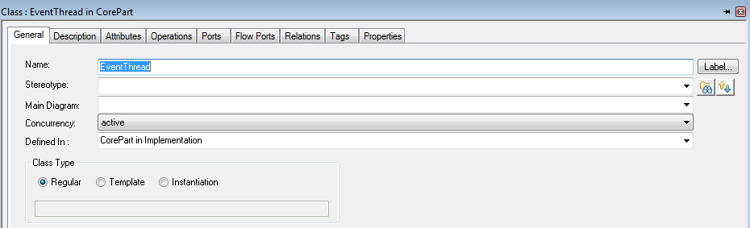
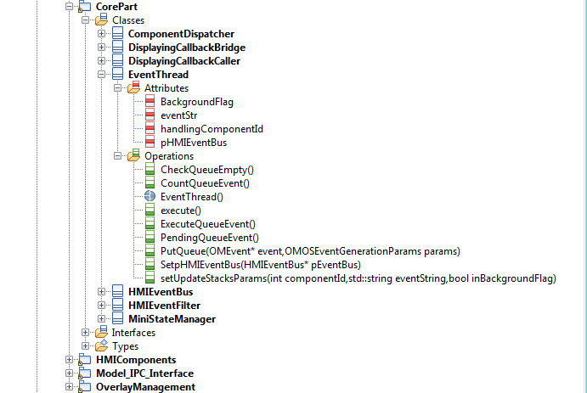
EventQueue Thread
Change Concurrency to Active

Slide 17
startDispatching(): Start event processing loop with execute function
In this case, we override execute function for our purposes

Slide 18
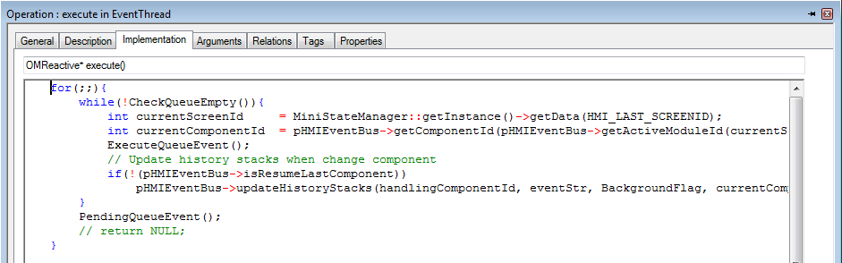
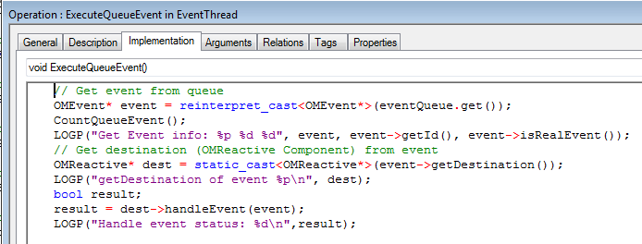
Execute

Slide 19
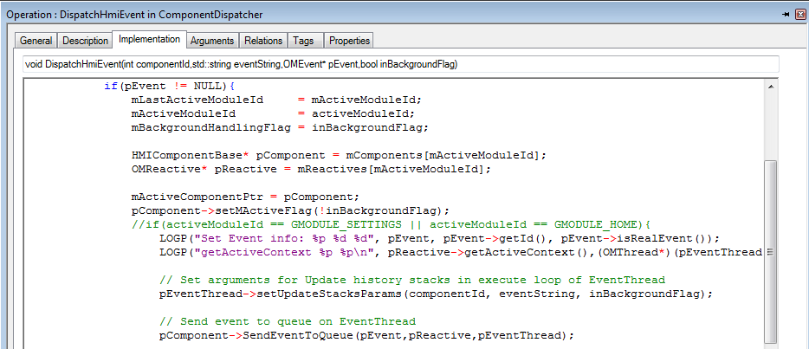
ComponentDispatcher
EventQueue
Queue Events
Components
- Receive Event From ComponentDispatcher
Set destination of Event to themselves

Slide 20
Q&A

Slide 21


